Slide 1

Python Programming
(Business & Analytics)
by Su Lee Seng,
Jan, 2021

Slide 2
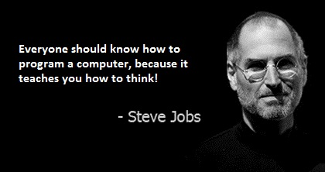
Python Programming
(Business & Analytics)
by Su Lee Seng,
Jan, 2021

Slide 3
Talk is cheap.
show me the code.

Slide 4

SAP HANA – An Introduction
@ UTAR
by Su Lee Seng,
April, 2014.

Slide 5
Python Programming
Iteration / Looping

Slide 6
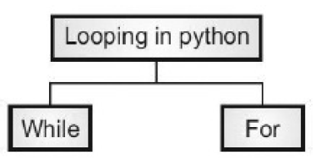
Python Programming – Iteration / Looping :
Loops in Python
xx

Slide 7
Python Scripts & Modules
WHILE - loop

Slide 8
Python Programming – Iteration / Looping :
While - Loop
The while loop exists in almost all programming languages and is used to iterative (or repeat) one or more code statements as long as the test condition (expression) is True. This iteration construct is usually used when the number of times we need to repeat the block of code to execute is not known. For example, it may need to repeat until some solution is found or the user enters a particular value.e
The Python while loop has the basic form:
while <test-condition-is-true>:
statement or statements

Slide 9
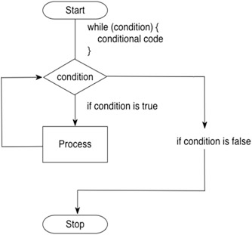
Python Programming – Iteration / Looping :
While - Loop
xxxx

Slide 10
Python Programming – Iteration / Looping :
While - Loop
While the test condition/expression is True then the statement or block of statements in the while loop will be executed.
Note that the test is performed before each iteration, including the first iteration; therefore, if the condition fails the first time around the loop the statement or block of statements may never be executed at all.
As with the if statement, indentation is key here as the statements included in the while statement are determined by indentation. Each statement that is indented to the same level after the while condition is part of the while loop.
Notes:
However, as soon as a statement is no longer following the while block; then it is no longer part of the while loop and its execution is no longer under the control of the test-condition.

Slide 11
Python Programming – Iteration / Looping :
While - Loop
count = 0
print('Starting')
while count < 10:
print() #print(count, ' ', end='') # part of the while loop
count += 1 # also part of the while loop
not part of the while loop
print('Done')
Initialise
Print out the count variable is run 10 times (printing out the values 0–9).
Output :
Starting
0 1 2 3 4 5 6 7 8 9
Done
Notes:
In this example while some variable count is less than the value 10 the while loop will continue to iterate (will be repeated). The while loop itself contains two statements; one prints out the value of count variable while the other increments count (remember count +=1 is equivalent to count = count + 1).
We have used the version of print() that does not print a carriage return when it prints out a value (this is indicated by the end='' option passed to the print() function).

Slide 12
Python Programming – Iteration / Looping :
While - Loop
As you can see the statements printing the starting and done messages are only run once. However, the statement printing out the count variable is run 10 times (printing out the values 0–9).
Once the value of count is equal to 10 then the loop finishes (or terminates). Note that we needed to initialise the count variable before the loop. This is because it needs to have a value for the first iteration of the while loop.

Slide 13
Python Scripts & Modules
FOR - loop

Slide 14
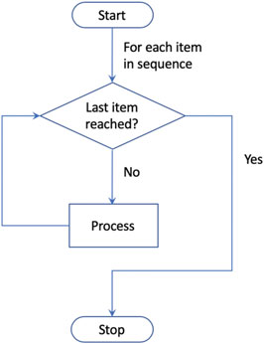
Python Programming – Iteration / Looping :
For - Loop
The for loop is used to step a variable through a series of values until a given test is met.
Many languages have a for loop of the form:
for i = from 0 to 10
statement or statements
In this case a variable 'i' would take the values 0, 1, 2, 3 etc. up to 10.

Slide 15
Python Programming – Iteration / Looping :
For - Loop
The format of the Python for loop when using a range of values is
for <variable-name> in range(...):
statement
statement
An example :
# Loop over a set of values in a range
print('Print out values in a range')
for i in range(0, 10):
print(i, ' ', end='')
print()
print('Done')
…from 0 to 9, not inclusive of 10.
Output :
Print out values in a range
0 1 2 3 4 5 6 7 8 9
Done

Slide 16
Python Programming – Iteration / Looping :
For - Loop
We could have decided to increment count by 2 each time round the loop (a very common idea). In fact, range allows us to do exactly this; a third argument that can be provided to the range function is the value to increment the loop variable by each time round the loop, for example:
# Now use values in a range but increment by 2
print('Print values in a range with increment of 2')
for i in range(0, 10, 2):
print(i, ' ', end='')
print()
print('Done')
Output :
Print values in a range with increment of 2
0 2 4 6 8
Done

Slide 17
Python Algorithms :
Iterative Functions (FOR-loops)
In the For Loops section, you were introduced to the syntax for looping over objects in Python. As a refresher, here is an example where you perform five iterations and print the i variable in each loop:
for i in range(5):
print(i)
>>> animals = [" cat", "dog", " bird "]
>>> for index in range (len( animals )):
... print index , animals [ index ]
Output :
0
1
2
3
4
Output :
0 cat
1 dog
2 bird
<< Exercise A48 >>
Notes:
For loops can also be placed within functions.

Slide 18
Include or Not.
Python Programming – Iteration / Looping :
For - Loop
One interesting variation on the for loop is the use of a wild card (a '_') instead of a looping variable; this can be useful if you are only interested in looping a certain number of times and not in the value of the loop counter itself, for example:
# Now use an 'anonymous' loop variable
for _ in range(0,10):
print('.', end='')
print()
In this case we are not interested in the values generated by the range per se only in looping 10 times thus there is no benefit in recording the loop variable. The loop variable is represented by the underbar character ('_').
Notes:
Note that in actual fact this is a valid variable and can be referenced within the loop; however by convention it is treated as being anonymous.

Slide 19
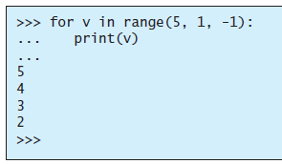
Python Programming – Iteration / Looping :
Examples
This illustration demonstrates the use of for-loop for iterating through a tuple.
T=(1, 2, 3)
for i in T:
print(i)
print(T)
Output :
1
2
3
(1, 2, 3)
Example :
Notes:
xxx

Slide 20
Python Programming – Iteration / Looping :
Break Loop Statement
The break statement allows a developer to alter the normal cycle of the loop based on some criteria which may not be predictable in advance (for example it may be based on some user input).
The break statement, when executed, will terminate the current loop and jump the program to the first line after the loop. The following diagram shows how this works for a for loop:

Slide 21
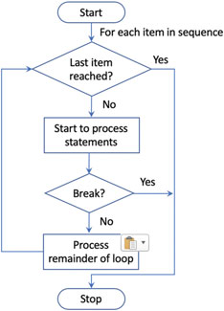
Python Programming – Iteration / Looping :
Break Loop Statement
Typically, a guard statement (if statement) is placed on the break so that the break statement is conditionally applied when appropriate.

Slide 22
Python Programming – Iteration / Looping :
Break Loop Statement
If the number is in the range, then we will loop until this value is reached and then break the loop (that is terminate early without processing the rest of the values in the loop):
print('Only print code if all iterations completed')
num = int(input('Enter a number to check for: '))
for i in range(0, 6):
if i == num:
break
print(i, ' ', end='')
print('Done')
If we run this and enter the value 3 .
Output :
Enter a number to check for: 3
0 1 2 Done

Slide 23
Python Programming – Iteration / Looping :
Break Loop Statement
If we run this and enter the value 7 (which is outside of the range)
Note that the string 'Done' is printed out in both cases as it is the first line after the for loop that is not indented and is thus not part of the for loop.
Output :
Enter a number to check for: 7
0 1 2 3 4 5 Done

Slide 24
Python Algorithms :
Break Loop Statement
You can exit the function at any point during the iterations. For instance, you might want the function to return a value once a certain condition is met.
Notice that a for loop construct contains a colon (:) followed by indented code. (The indented code is the block of the for loop).
<< Exercise A49 >>

Slide 25
Python Programming – Iteration / Looping :
Breaking out of a loop (break)
The break keyword will jump out of the nearest loop you are in. If you have a program that adds numbers until it comes to the first negative one, you could use break to stop when you hit a negative number:
>>> numbers = [3, 5, 9, -1, 3, 1]
>>> result = 0
>>> for item in numbers :
... if item < 0:
... break
... result = result + item
>>> print result
Output :
17

Slide 26
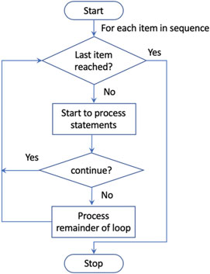
Python Programming – Iteration / Looping :
Continue Loop Statement
The continue statement also affects the flow of control within the looping constructs for and while. However, it does not terminate the whole loop; rather it only terminates the current iteration round the loop. This allows you to skip over part of a loop’s iteration for a particular value, but then to continue with the remaining values in the sequence.

Slide 27
Python Programming – Iteration / Looping :
Continue Loop Statement
The continue keyword tells Python to disregard processing of the current item in the for loop and “continue” from the top of the for block with the next value in the loop.
>>> numbers = [3, 5, 9, -1, 3, 1]
>>> result = 0
>>> for item in numbers :
... if item < 0:
... continue
... result = result + item
>>> print result
Output :
21

Slide 28
Python Programming – Iteration / Looping :
Continue Loop Statement
A guard (if statement) can be used to determine when the continue statement should be executed.
As with the break statement, the continue statement can come anywhere within the body of the looping construct. This means that you can have some statements that will be executed for every value in the sequence and some that are only executed when the continue statement is not run.
for i in range(1,11,1):
if i == 5:
continue
print(i, end=” “)
Output :
1 2 3 4 6 7 8 9 10

Slide 29
Python Programming – Iteration / Looping :
Continue Loop Statement
In this program the continue statement is executed only for odd numbers and thus the two print() statements are only run if the value of i is even:
for i in range(0, 10):
print(i, ' ', end='')
if i % 2 == 1:
continue
print('hey its an even number')
print('we love even numbers')
print('Done')
Output :
0 hey its an even number
we love even numbers
1 2 hey its an even number
we love even numbers
3 4 hey its an even number
we love even numbers
5 6 hey its an even number
we love even numbers
7 8 hey its an even number
we love even numbers
9 Done
Notes:
As you can see, we only print out the messages about a number being even when the values are 0, 2, 4, 6 and 8.

Slide 30
Python Programming – Iteration / Looping :
Continue Loop Statement - Example
Read the string “Hello World” from the user. Make use of continue keyword and remove space.
str1=str(input(“Please Enter the String: “))
print(“ Entered String is : “, str1)
print(“ After Removing Spaces, the String becomes:”)
for i in str1:
if i==” “:
continue
print(i, end=””)
Output :
Please Enter the String: Hello World
Entered String is : Hello World
After Removing Spaces, the String becomes:
HelloWorld
Notes:
, 2, 4, 6 and 8.

Slide 31
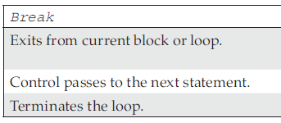
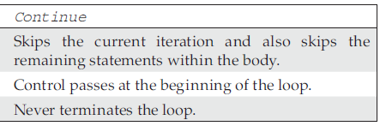
Python Programming – Iteration / Looping :
Difference between break and continue functions
xxx

Slide 32
Python Programming – Iteration / Looping :
For Loop with Else
Python's else clause can be used on a for or while statement as well as on an if statement. The else clause executes after the loop body if there was no break statement executed. Here's an example:
>>> for item in 1,2,3:
... print(item)
... if item == 2:
... print("Found",item)
... break
... else:
... print("Found Nothing")
Output :
1
Found Nothing
2
Found 2
The value of three isn't shown, nor is the "Found Nothing" message in the else clause.

Slide 33
Python Programming – Iteration / Looping :
For Loop with Else
The for statement here will iterate over a short list of literal values. When a specific target value has been found, a message is printed. Then, the break statement will end the loop, avoiding the else clause.
The value of three isn't shown, nor is the "Found Nothing" message in the else clause.

Slide 34
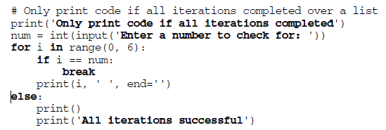
Python Programming – Iteration / Looping :
For Loop with Else
A for loop can have an optional else block at the end of the loop. The else part is executed if and only if all items in the sequence are processed. The for loop may fail to process all elements in the loop if for some reason an error occurs in your program (for example if you have a syntax error) or if you break the loop.

Slide 35
Python Programming – Iteration / Looping :
For Loop with Else
If we run this code and enter the integer value 7 as the number to check for; then the else block executes as the if test within the for statement is never True and thus the loop is never broken, and all values are processed:
Output :
Only print code if all iterations completed
Enter a number to check for: 7
0 1 2 3 4 5
All iterations successful

Slide 36
Python Programming – Iteration / Looping :
For Loop with Else
However, if we enter the value 3 as the number to check for; then the if statement will be True when the loop variable 'i' has the value 3; thus only the values 0, 1 and 2 will be processed by the loop. In this situation the else part will not be executed because not all the values in the sequence were processed:
Output :
Only print code if all iterations completed
Enter a number to check for: 3
0 1 2

Slide 37
Python Programming – Iteration / Looping :
Naming Convention - Loop Variable Naming
loop variable names used with for loops over ranges. It is very common to find that these loop variables are called 'i', 'j' etc.
It is such a common convention that if a variable is called 'i' or 'j' people expect it to be a loop variable. As such
you should consider using these variable names in looping constructs,
and avoid using them elsewhere.

Slide 38
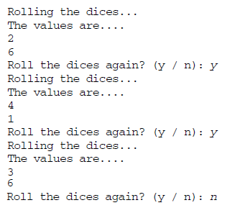
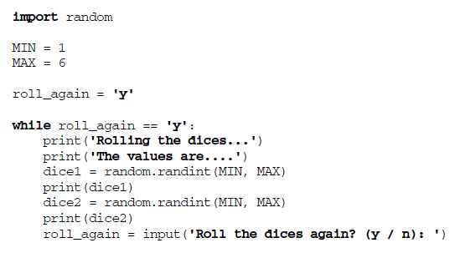
Python Programming – Iteration / Looping :
Example (Dice Roll Game)
xxxx
Discuss advantages if using variables.
…determines the value of variable roll_again.

Slide 39
Python Programming – Iteration / Looping :
Online Resources
See the Python Standard Library documentation for:
• https://docs.python.org/3/tutorial/controlflow.html the online Python flow of control tutorial.
<< Exercise B7 >>

Slide 40
Thank you

